Slide 1

Multinational company Ecom. & Retail B2B case Study
Name – Mukesh sharma
Batch – Feb 20

Slide 2
Index
1. Problem Statements and Goal to achieve
2. Approach to reach Goal
3. EDA and outcomes
4. Customer Segmentation
5. Model building
6. Model Validation
7. Selection of Model
8. Deployment of Model
9. Summary

Slide 3
Problem statement and Goal to achieve
Problem Statement
Schuster is a multinational retail company dealing in sports goods and accessories. Schuster conducts significant business with hundreds of its vendors, with whom it has credit arrangements. Unfortunately, not all vendors respect credit terms and some of them tend to make payments late. Schuster levies heavy late payment fees, although this procedure is not beneficial to either party in a long-term business relationship. The company has some employees who keep chasing vendors to get the payment on time; this procedure nevertheless also results in non-value-added activities, loss of time and financial impact. Schuster would thus try to understand its customers’ payment behavior and predict the likelihood of late payments against open invoices.
Goal
How can we analyze the customer transactions data to find different payment behaviors?
In which way can you segregate the customers based on their previous payment patterns/behaviors?
Based on the historical data, can you predict the likelihood of delayed payment against open invoices from the customers?
Can you draw any business insights based on your developed model?
Overall, you need to build a model with the primary objective of identifying important predictor attributes that will help the business understand indicators of late payment.

Slide 4
Approach to reach Goal
Importing required libraries, reading and understanding the data
Through EDA do, Data Cleaning- data quality checks including check for duplicate records, missing values and outliers
Data Visualization through plots and graph
Customer Segmentation to understand the customer behaviour
Data Preparation including check for Data Imbalance
Building model > Logistic Regression and Evaluation
Building model > Random Forest including Hyper Parameter Tuning and Evaluation of the model
Prediction on the test set
Model Deployment on the open invoices
Customer Insights on open invoices.

Slide 5
EDA (Exploratory data Analysis)
Received payment data File imported as rpd.
Also, we have opened the open invoice file as oid.
Perform data cleaning ( Duplication, null value, Missing value, outliers etc.)
Fore more in-depth understanding we have plot the graph between transaction and it’s frequency and we found most are in millions
Also, we did the outlier studies in terms of amount and found more than 4 million are outliers
We have plot the graph for receipt method and found maximum payments are coming through wire
We have removed the customer mobile number as we found some customer having more than one and it can affect our model building
We have observed that 30 & 60 days are most immediate payments
Invoice Allocated is also Seems not useful hence dropped
Clubbed few of payments terms to make it understanble terms

Slide 6
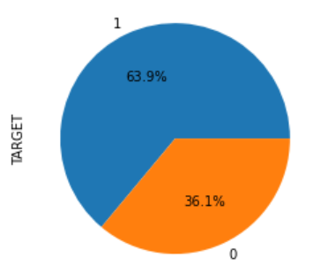
We have segregated the payment terms into Good or nongood and we found 52% are good and remain 47% are concern terms
Through pie chart we can see the customer whose payment
Is due form the date of purchase.
By plotting invoice year we see most of the invoice are
done in 2021.
We also have observed that maximum of due was done from 6th to 12th of the year
The preferred mode of payment by customers is WIRE; the default is 100% in case of I/C check.
30 days from EOM or invoice date are popular payment terms, but delay is high in case of Paymnet terms- 15 days from EOM, Immediate and 100% Advance Payment.
Schuster's Non Goods Invoices are almost as high as goods invoices
Invoices are mostly raised in AED,SAR and USD, however we see delay rate is 100% where invoice currency is JOD or ZAR.
Customers making payment in KWD are 100% likely to delay the payment.

Slide 7
Invoices raised in Jul-Sep period have seen a considerable delay in paymnents by customers.
Invoices due on Monday and Thursday have not been paid on time on most occasions.
Schuster has raised very less invoices on friday compared to other days.
Most of Schuster's billings are for less than 1 Mn. It does have some very high value transactions upto 10 Mn
64:36 is the ratio of delayed to timely payments.

Slide 8
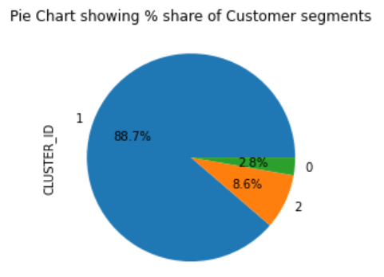
Customer Segmentation
We will understand the customer nature of payment in different segments like date, day or month.
Then we will merge those customers whose behavious leads to the delay in payment
We are seeing some customer has did the advance payment
We will do the clustering of all delay payment customer for our model

Slide 9
Model building
We will do the train split test
Now we will do the logistics regression post creation of train split tests models
We will do the selection using RFECV tool form library
Now call the ref upon the train test model
Let's import the statsmodels.api
For the fist model we find 14 features in which some col haviging high p values, we will delete one col with 1 P valaue and recreate one more model
After deleting all the P values more than 0.005 we have get the check for VIF which is should give col value below 5.

Slide 10
Model Validation
The Accuracy out model gets – 0.78 and accuracy and recall value – 0.95 which is a good number
We can see that model5 gives an accuracy of 78.26% on train set. Also the recall/sensitivity score is 84%. Specificity is 69% and precision is 82%.This looks good. Let us plot the ROC Curve
We will have the model building Random Forest, Hyper Parameter Tuning and Evaluation
Random Forest rf_best gives an accuracy of 78%. Also it has a very good recall/sensitivity score of 90% on the train set. The auc in the roc curve is at 0.80.
Let us see how the logistic regression model- model 6 and random forest - rf_best perform on the test set
Good performance on test set.Sensitivity/recall score is 89% and accuracy is 74% and is very close to the test score
Good sensitivity/recall score on train and test data i. e 0.90.

Slide 11
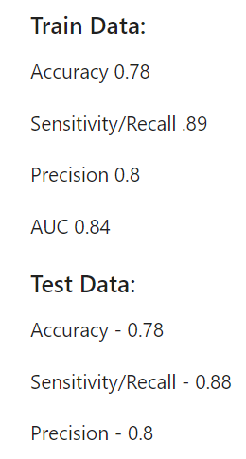
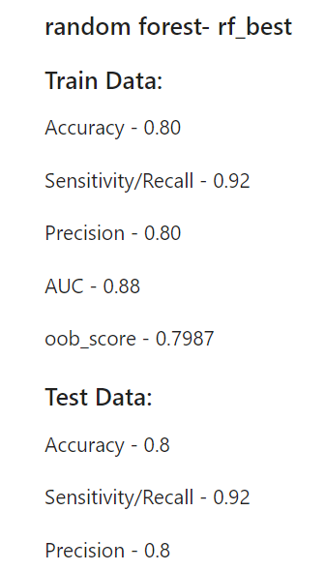
Selection of Model
Since Random Forest performance is better,
we will use this model ref_best for deployment.

Slide 12
Deployment of Model on open invoices
We will first perform the EDA on the working file after importing it
Also, we are observing lots of below zero values in USD amount
Only 6 customers have positive USD amount transaction
Focus for Credit Collection
Focus on all cases pertaining to Cluster 0 as these are cases of prolonged delays.
Frequent follow up on cases with huge invoice value or huge volume of transactions.
SEPH can have a dedicated person for follow up as their business value and volume of invoices is huge.
Priority should be given to follow up with customers who have high probability of default or delay % is 100%.
During follow up special attention should be paid for invoices due in Mar , Jul-Oct and due on friday and sunday.
Also, be proactive where invoicing currency is ZAR,HKD,SGD,OMR and GBP.

Slide 13
Summary
Schuster has to build some mechanism to give reminder to customer whose payment is getting delayed.
Arrange the call and understand the issue of delay, if it something related to customer grievance resolve it
Schuster has to focus to have the intime payment received percentage increasing
Schuster should work on the clustomer_2 customer whose payment delay chances are more

